Slide 1
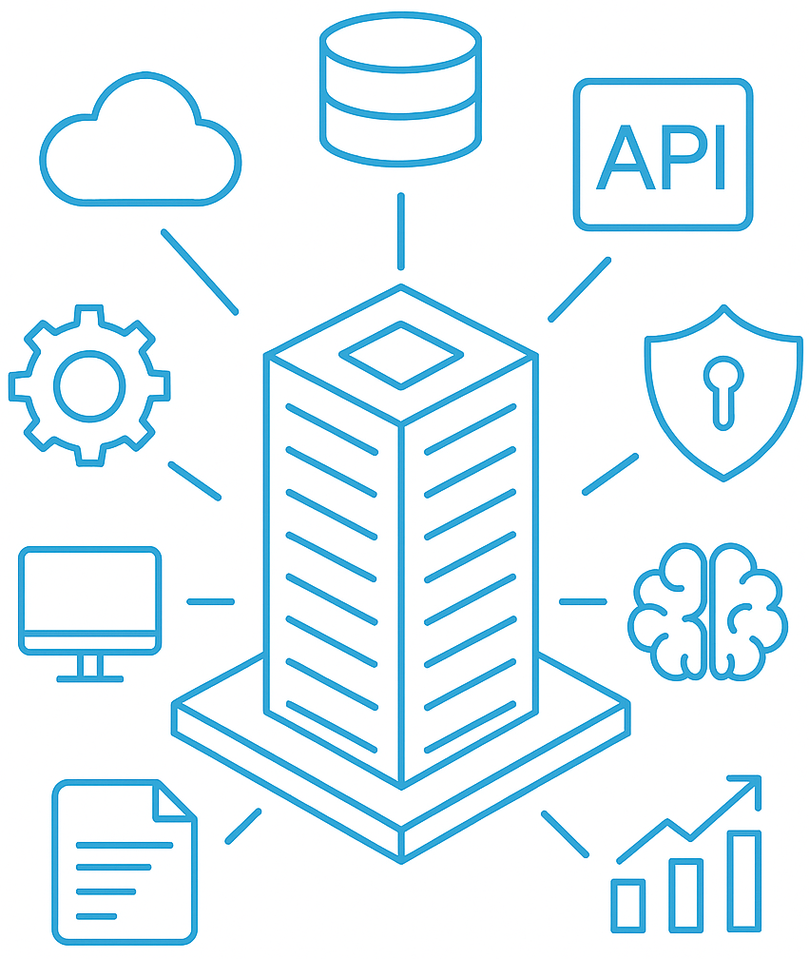
ReframeEA
Architecture domains
How to turn EA into transformation

Slide 2
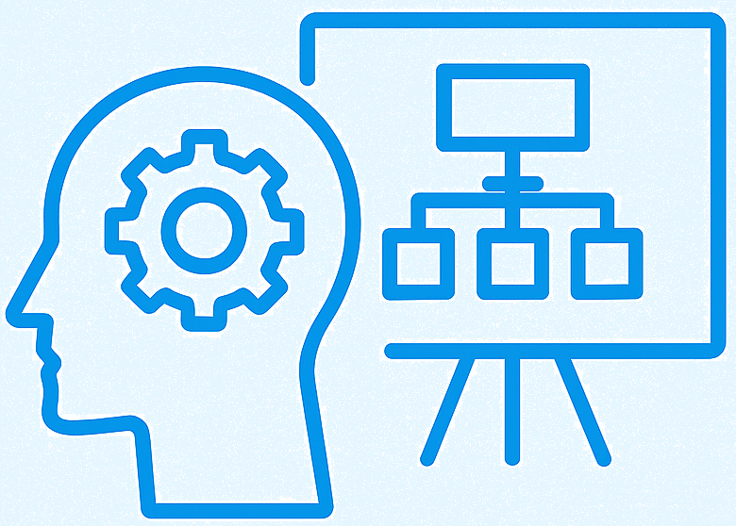
Table of Contents
Introduction
Aim of this session
Definition of architecture domains
How to turn EA into transformation plan
  Role of IT Architect
  Structured approach - Methodology
Join me

Slide 3
Introduction
Who am I
How did I met Gábor?
What am I doing here?

Slide 4
Aim of this session
Define how broad architecture is
It is a discussion starter
No intention to raise walls
Check our interests
Survey our representation
How to turn EA into actionable transformation steps
Bring knowledge and experience to the table
Group people with specific interest
Method proposal
Share my knowledge
Join me if we share the same interest

Slide 5
Definition of architecture domains (What we do)
Enterprise Architect
EA is in charge to define long-term vision how the organization can achieve its strategy
EA defines the capabilities, information, applications, technology and investment needed to achieve the goal on a conceptual level
Is in charge to define constraints, governance, requirements and guidelines for the organization.
Note: Intetion is to help us understand our domains, not to define a 100% accurate definition.
Business
Architecture (BA)
IT Architecture
IT Architect
IA is in charge to translate the EA vision into actionable steps using the constraints, requirements and guidelines.
Lead team to deliver successful projects.
Hold contact with the business, PM and stakeholders
Responsible to create documentation about:
  Requirements definition
  Architectural decisions,
  Application system context
  Application architecture overview
  Components model
  Deployment unit model
Enterprise Architecture (EA)
Solution Architecture (SA)
Notes:
Enterprise architecture:
“The definition of enterprise frameworks, models, mechanisms, and structures so that the business, information system, and technology capability of an enterprise evolves in a manner that effectively supports the business strategy or intent; this includes assisting enterprises to plan and prioritize initiatives that optimize business and IT investments; and the many individual initiatives that deliver solutions are guided or constrained in a manner that reduces the fragmentation and variation that is the natural result of business units or groups delivering solutions in an autonomous manner.”

Slide 6
Definition of architecture domains (What we do) - Con’t
Business Architect
Works closely with Enterprise Architect and Solution Architect
BA is in charge to define long-term vision how the organization can achieve its strategy
BA is in charge to define the business domains of the organization (HR, Payroll, Manufacturing, Marketing, etc)
BA is in charge to document the different business processes are going to flow, what capabilities each need to deliver, what inputs and resources it needs
BA define governance around these business processes
Business
Architecture (BA)
IT Architecture
Solution Architect
Works closely with IT Architect
Translates the IT Architecture’s component models into executable code
Translates the IT Architecture’s deployment model into configuration and network setup
Enterprise Architecture (EA)
Solution Architecture (SA)
Notes:
Enterprise architecture:
“The definition of enterprise frameworks, models, mechanisms, and structures so that the business, information system, and technology capability of an enterprise evolves in a manner that effectively supports the business strategy or intent; this includes assisting enterprises to plan and prioritize initiatives that optimize business and IT investments; and the many individual initiatives that deliver solutions are guided or constrained in a manner that reduces the fragmentation and variation that is the natural result of business units or groups delivering solutions in an autonomous manner.”

Slide 7
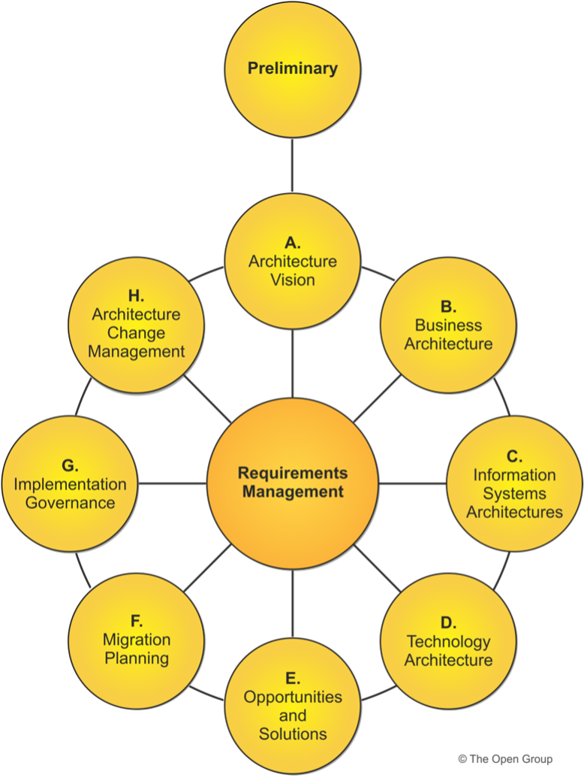
Turn EA into transformation plan
Enterprise Architecture has been defined – Now what?
Many organization get stuck here
Share with the IT Architects:
  Vision, business goals
  Constraints (Enterprise Environment, External environment, Existing environment)
  Guidelines
Run Architecture Review Board

Slide 8

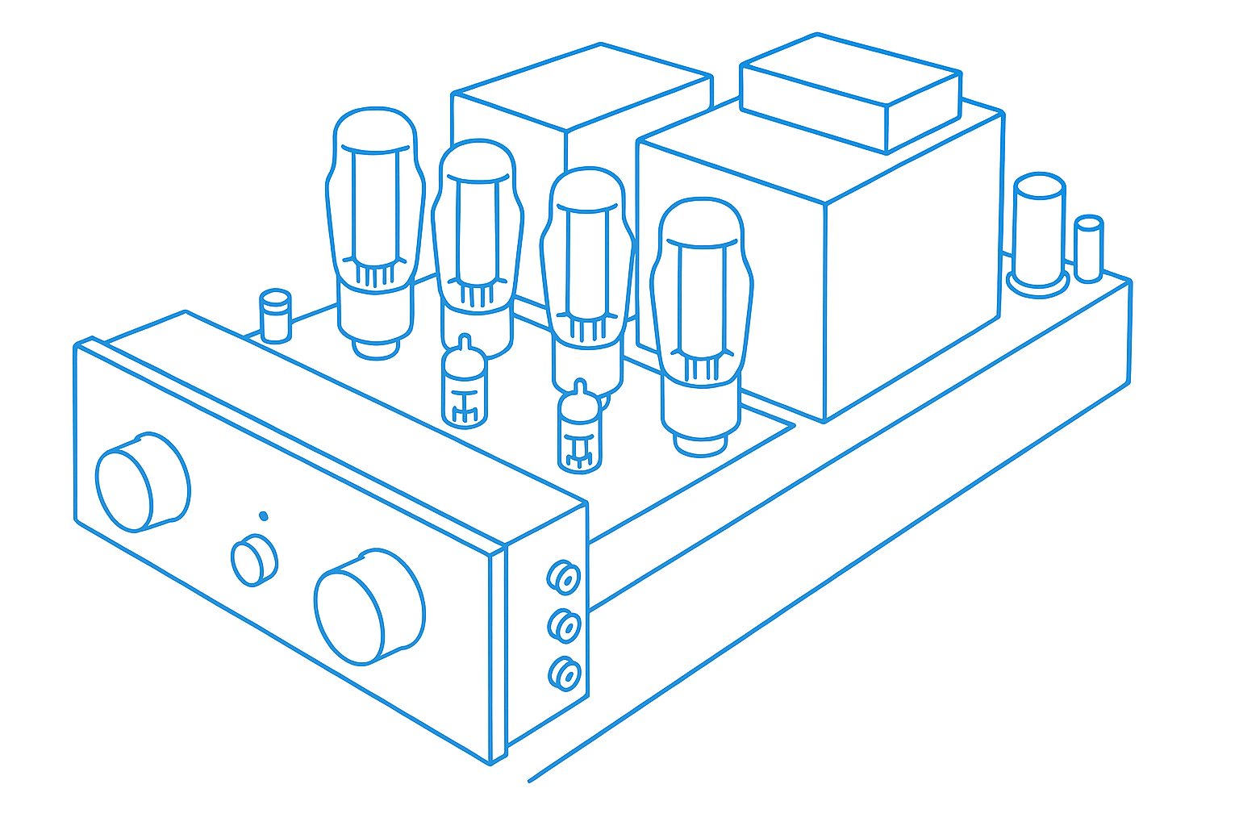

Role of the IT Architect
Each organization has this role and person. Wether that person works using a framework or named as such is not certain.
The IT architect is in charge to:
Translate EA (BA) vision into individual transformation projects
Work with the business to identify which project can be executed (resources)
Lead the selected projects
Keep contact with stakeholders
Define the IT (Application) level architecture while:
  Keep the overarching principle in mind (EA)
  Being mindful about design and SA
Create documentation of the project
Architecting the Amplifier
Requirements
Structure’s Requirements
Requirements Model
Requirements Guidance
Architecture
Architecture Model
Architecture Guidance
Creating the Structure (Architects)
Design
Detailing the Content (Designers)
Design
Model
Design
Guidance

Slide 9
Structured approach – Methodology
IT Architects should look at a problem in a number of dimensions to organise their thoughts
What is your system actually going to do? How are its applications and software organised?
Functional
Operational
Where is your system going to operate? How are the computers inter-connected and how many will you need?
Build-time
Run-time
How does your system and application get developed, integrated and tested?
What happens to your system when it runs? How will it be managed over its lifetime?
Technology
Process
People

Slide 10
Structured approach – Methodology
IT Architects should look at a problem in a number of dimensions to organise their thoughts
Application level
Technical level
Physical perspective
Logical perspective
Functional aspect
Operational aspect

Slide 11
Structured approach – Methodology
IT Architects should look at a problem in a number of dimensions to organise their thoughts
Document the following:
Gathered requirements
  Functional requirements
  Non-Functional requirements
Architectural decisions
System context diagram
Architecture overview
Component model, data model
Deployment unit model
Validation and viability
Master test plan
Go-live planning
Data migration plan
Application level
Technical level
Physical perspective
Logical perspective
Functional aspect
Operational aspect

Slide 12
Joine me
Collaborate on the architect definitions: https://github.com/milanboros/ReframeEA
Contact me if you are interested to create a sub-group for IT Architecture methodology:
Whatsapp – „Architecture Community – Hungary” - https://chat.whatsapp.com/GX6K3OsaZeU58JiZGb1F0E?mode=gi_t
https://www.linkedin.com/in/milan-boros/

